Slide 1
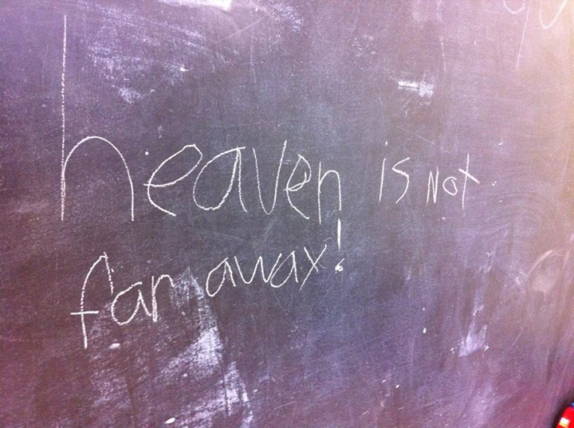

Slide 2
The
Kingdom of Heaven
And Its Sarim

Slide 3
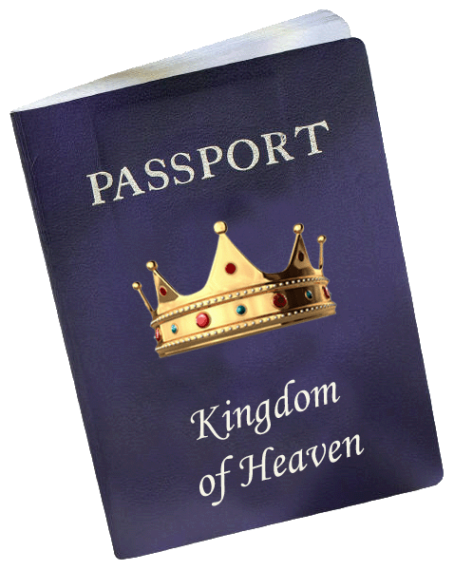
The
Kingdom of Heaven
And Its Princes
Heaven is a Kingdom.
Jesus is the King.

Slide 4
The
Kingdom of Heaven
And Its Princes
Heaven is a Kingdom.
Jesus is the King.
The Kingdom is “among you” (Luke 17.21) because Jesus rules in believers, and through them!

Slide 5
The
Kingdom of Heaven
And Its Princes
Our citizenship in the Kingdom began when we were born into it by the will of God (John 1.12-13).
We were born to serve the King, but also to rule with Him.

Slide 6
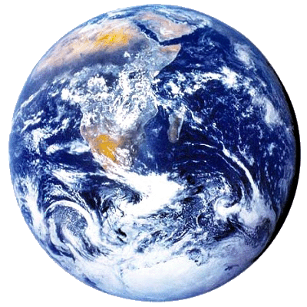
The
Kingdom of Heaven
And Its Princes
God gave the dominion of the Earth to man (Gen 1.26-28).

Slide 7
The
Kingdom of Heaven
And Its Princes
Man sold out his dominion to Satan.

Slide 8
The
Kingdom of Heaven
And Its Princes
Man sold out his dominion to Satan.
Jesus redeemed it as our Kinsman (Lev. 25.25).

Slide 9
The
Kingdom of Heaven
And Its Princes
Man sold out his dominion to Satan.
Jesus redeemed it as our Kinsman (Lev. 25.25).
God, through Christ, disarmed usurping authorities (Col. 2.15).

Slide 10
The
Kingdom of Heaven
And Its Princes
Legally, we have spiritual authority over our planet now (Matthew 28.19; Ephesians 1.18 to 2.7).

Slide 11
The
Kingdom of Heaven
And Its Princes
Legally, we have spiritual authority over our planet now (Matthew 28.18-19; Ephesians 1.18 to 2.7).
We will receive admini-strative authority over nations when Jesus returns (Rev 2.26-27; 5.9-10).

Slide 12
The
Kingdom of Heaven
And Its Princes
WAIT! Aren’t we going to Heaven when we die?

Slide 13
The
Kingdom of Heaven
And Its Princes
WAIT! Aren’t we going to Heaven when we die?
Yes, but Heaven is coming to Earth (Rev 21.2-3). Our future destiny is on the Earth (old Earth and new).

Slide 14
The
Kingdom of Heaven
And Its Princes
What will
our future reign
look like?

Slide 15
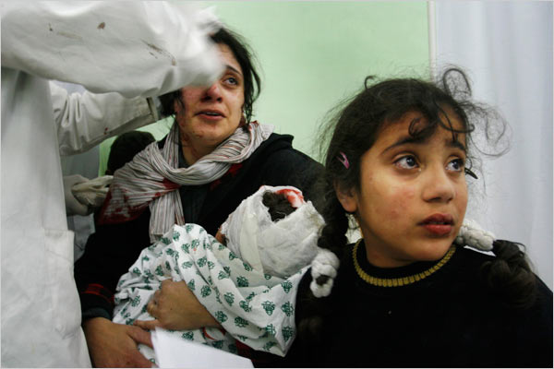
The
Kingdom of Heaven
And Its Princes
It will begin with ministering to traumatized people...

Slide 16
The
Kingdom of Heaven
And Its Princes
Isaiah 32 describes this time:
¹ Behold, a king will reign righteously And princes [sarim] will rule justly.
² Each will be like a refuge from the wind And a shelter from the storm, Like streams of water in a dry country, Like the shade of a huge rock in a parched land. (NASB)

Slide 17
The
Kingdom of Heaven
And Its Princes
Isaiah 32 describes this time:
³ Then the eyes…will not be blinded, And the ears…will listen.
⁴ The mind of the hasty will discern the truth… (NASB)
Compare this with
2Corinthians 4.4!

Slide 18
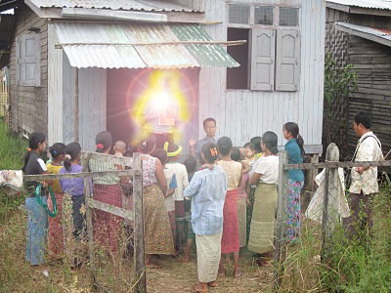
The
Kingdom of Heaven
And Its Princes
We will continue to rule by shepherding towns & cities (Luke 19.12-19).

Slide 19
The
Kingdom of Heaven
And Its Princes
Where will
we live?

Slide 20
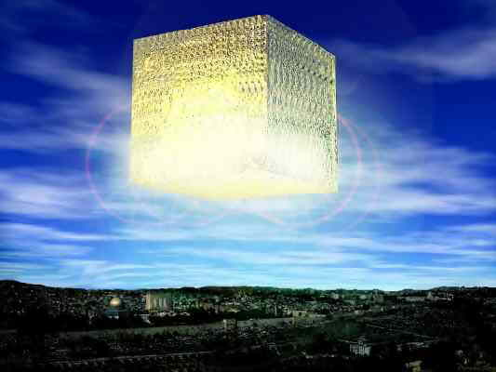
We will commute from New Jerusalem (Revelation 21.2; 22.14).

Slide 21
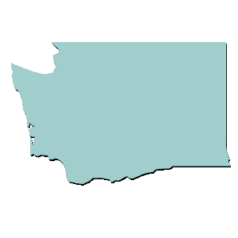
The
Kingdom of Heaven
And Its Princes
New Jerusalem will not land on Earth; it’s a 1,500-mile cube.

Slide 22
The
Kingdom of Heaven
And Its Princes
New Jerusalem has streets of gold and gates made of giant pearls; it’s where our traditional heaven imagery comes from .

Slide 23
The
Kingdom of Heaven
And Its Princes
Pearls are a symbol of value; no one enters this city who has not recognized the surpassing value of God’s Kingdom (Matthew 13.45-46).

Slide 24
The
Kingdom of Heaven
And Its Princes
The city is cubical, the shape of the Holy of Holies (1Kings 6.20).
No one enters this city who is not holy.

Slide 25
The
Kingdom of Heaven
And Its Princes
How will we
commute
between the
Heavenly City
and Earth?

Slide 26
The
Kingdom of Heaven
And Its Princes
In our present bodies, we must move to another place slowly.
In our heavenly bodies, we will think ourselves to another place instantly (see 1John 3.2).

Slide 27
The
Kingdom of Heaven
And Its Princes
A more important
question:
Will we live now
in the light of
what’s ahead?

Slide 28
The
Kingdom of Heaven
And Its Princes
Paul in Philippians 3.8-11 said:
⁸ I count all things to be loss…that I may gain Christ…
⁹ and be found in Him…
¹⁰ that I may know Him, and the power of His resurrection and the fellowship of His sufferings, being conformed to His death;
¹¹ in order that I may attain to the resurrection from the dead. (NASB)

Slide 29
The
Kingdom of Heaven
And Its Sarim

